Slide 1
Cloud Computing (Azure: AZ-900) Workshop
Enter to Learn & Exit to earn
Abhishek Panda
(Senior Solution Architect / Assistant Vice President)

Slide 2
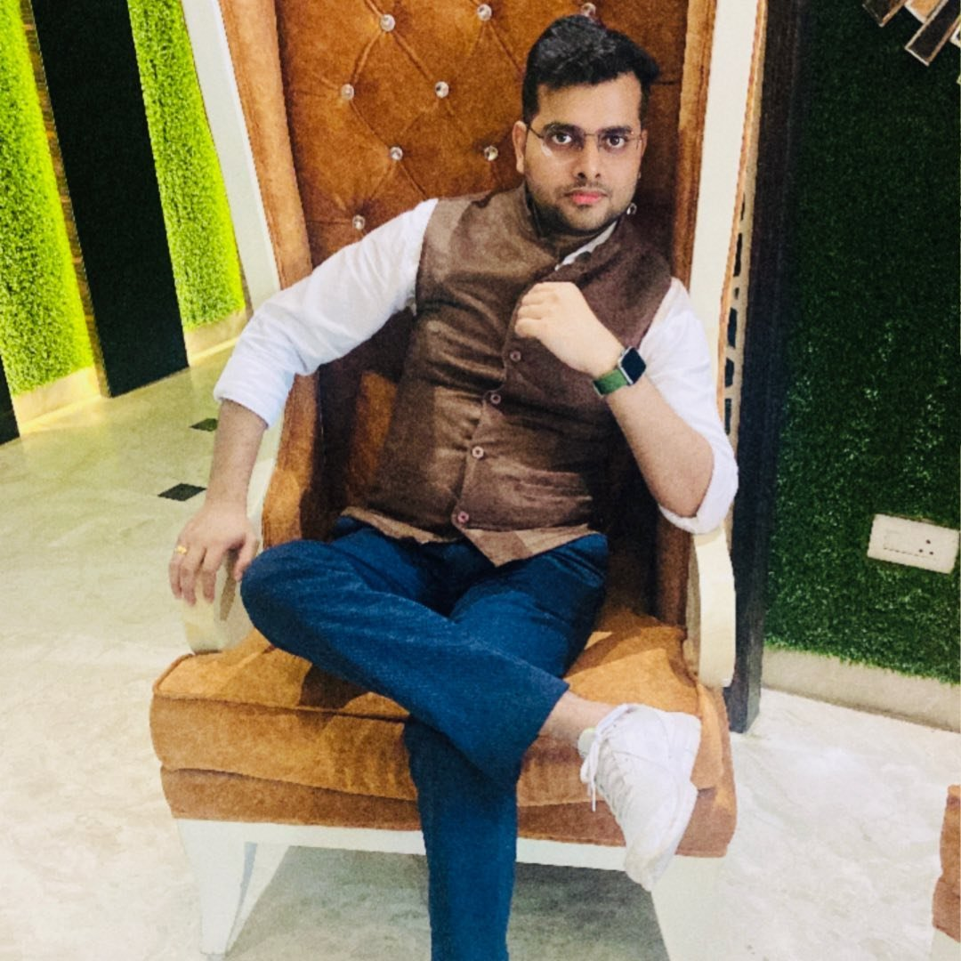
Who am I ?
Present Profile : Assistant Vice President in
Wells Fargo (USA 2nd Largest Bank )
Past Work profile :
Senior Solution Architect (Azure Solution Architect)
Technical Analyst in QATAR AIRWAYS (DOHA , QATAR)
Senior Software Developer in UK E-Commerce giant
#Dreamer #Explorer #Tech Enthusiast
Abhishek Panda (Senior Solution Architect)

Slide 3
Workshop Details
Workshop Duration 1 Week (Alternative Day )
Dates : 5th , 7th & 9th Apr 2022 (3 Days ) → 1 Hours Each day
→ Cloud Computing (Azure ) Details , career Scope , Salary on Azure
→ Doubt Clearing Session about Various Trending Technology , Career, Resume Building, Interview Preparation, Salary Negotiation Skills .
Abhishek Panda (Senior Solution Architect)

Slide 4
Topics to be covered
Cloud Computing Intro and Why Cloud Computing
→ Azure Fundamentals (Az-900 )
→ Other Certification Paths for Azure and Materials.
→ What is Next for career Benefits and Salary Increment
→ Resume Building
→ Technology to learn with Azure
→ Real Time Market Trend
→ Best Career Guidance from Real Time Expert
→ How to Present yourself to MNC and Start Up
→ Salary Negotiation Skills (Really Important for Freshers and Experienced)
→ Other Doubts related to technology and Career after B.Tech / M.tech/ MCA
Abhishek Panda (Senior Solution Architect)

Slide 5

WHAT NEXT ?
Abhishek Panda (Senior Solution Architect)

Slide 6
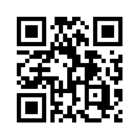
Connect With Me
My Dear Friends ,
Please Connect With me
Facebook : https://www.facebook.com/people/Abhishek-Panda/100072435410563/
Linked in : https://www.linkedin.com/in/abhishek-panda-956312213/
Instagram : https://www.instagram.com/the_abhishekpanda/
Telegram :
Abhishek Panda (Senior Solution Architect)

